Slide 1



Slide 2

Group members
Name : Roll No:
BILAL KHALIQ
SAAD KHALID
ANNAS IHSAN
HASSAN TARIQ
Ateeb Ur Rehman
M. Uzair SP24-BCS-098

Slide 3
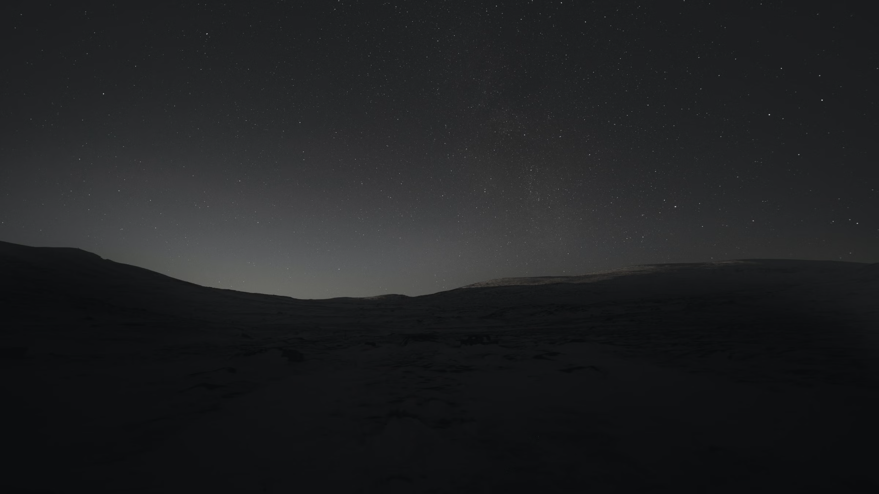



What is a Black Hole?
A black hole is a region in space where the gravitational pull is so strong that nothing, not even light, can escape. These mysterious cosmic objects are formed when a massive star collapses in on itself, creating an incredibly dense and compact object.

Slide 4

The Formation of Black Holes
1
Massive Star Collapse
When a massive star, many times the size of our sun, exhausts its fuel, the immense gravitational forces cause it to dramatically collapse in on itself.
2
Density and Gravity
As the star compresses, its density increases exponentially, creating an incredibly strong gravitational field that warps the very fabric of space and time.
3
Escape Velocity Exceeded
The gravitational pull becomes so strong that even light cannot escape, forming an event horizon - the point of no return. This marks the birth of a black hole.

Slide 5

Singularity and Event Horizon
At the center of a black hole lies the singularity, a point of infinite density where the laws of physics break down. This singularity is surrounded by the event horizon, the boundary beyond which nothing, not even light, can escape the black hole's immense gravitational pull. Once an object crosses the event horizon, it is doomed to be crushed by the singularity, never to be seen again.

Slide 6
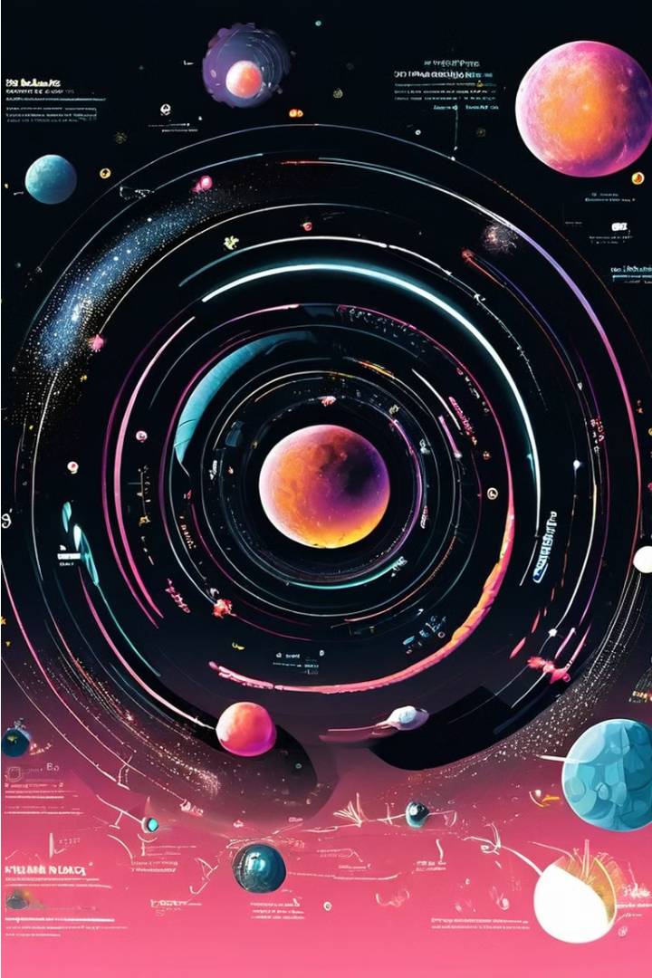
Types of Black Holes
Stellar Black Holes: Formed by the collapse of massive stars.
Supermassive Black Holes: Found at the centers of galaxies, containing millions or billions of solar masses.
Intermediate Black Holes: Intermediate in size between stellar and supermassive black holes.

Slide 7

Properties of black holes
Event Horizon: The boundary beyond which nothing can escape a black hole’s gravitational pull.
Singularity: A point of infinite density at the core of a black hole.
Spacetime Curvature: Black holes distort the fabric of spacetime around them.

Slide 8

Observing Black Holes
Observing black holes is a challenging yet crucial endeavor for astronomers. Advanced telescopes and sophisticated instrumentation are required to detect the telltale signs of these elusive cosmic phenomena, from the distortion of surrounding space-time to the luminous accretion disks of matter swirling towards the event horizon.

Slide 9
Supermassive Black Holes
Galactic Powerhouses
Feeding Frenzy
Supermassive black holes, millions or billions of times the mass of our Sun, reside at the heart of most galaxies, governing the dynamics and evolution of their entire galactic neighborhoods.
These colossal black holes are fueled by a constant influx of gas, dust, and even stars, which are drawn into a swirling accretion disk before being consumed by the singularity.
Energetic Outbursts
Weighing the Galaxy
As matter falls into a supermassive black hole, it releases enormous amounts of energy in the form of powerful jets and radiation, which can impact the surrounding galaxy on a grand scale.
By studying the motion of stars and gas around the galactic center, astronomers can precisely measure the mass of the supermassive black hole, providing insights into the evolution and structure of the host galaxy.

Slide 10




Hawking Radiation and Black Hole Evaporation
Quantum Effects
According to quantum mechanics, virtual particle-antiparticle pairs are constantly forming and annihilating near the event horizon of a black hole.
Hawking Radiation
Sometimes, one of the virtual particles falls into the black hole, while the other escapes, causing the black hole to emit a tiny amount of thermal radiation known as Hawking radiation.
Black Hole Evaporation
Over an incredibly long time, the gradual emission of Hawking radiation causes the black hole to lose mass and energy, eventually leading to its complete evaporation.

Slide 11
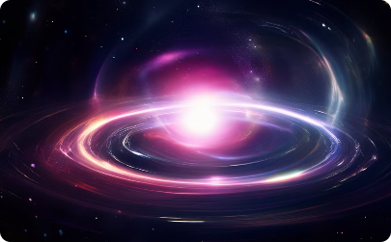
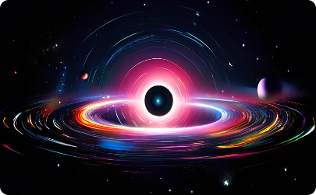
Gravitational Lensing and Black Holes
Gravitational Lensing
Observing Lensing Effects
The immense gravity of black holes can bend and magnify the light from distant galaxies, creating the stunning phenomenon of gravitational lensing, which provides a unique window into the unseen universe.
By studying the intricate patterns of gravitational lensing around black holes, astronomers can map the distribution of matter, measure the mass of the black hole, and even detect the presence of unseen objects in the cosmos.

Slide 12
Unsolved Mysteries and Future Research
Unresolved questions about black holes include the information paradox
Reconciling black holes with quantum mechanics
The possibility of black hole wormholes.

Slide 13



The Future of Black Hole Research
Unprecedented Observations
1
Next-gen telescopes and instruments will enable unprecedented observations of black holes.
Unraveling Mysteries
2
Shedding light on the nature of singularities and exploring the limits of physics.
Cosmic Laboratories
3
Using black holes as natural laboratories to test theories of gravity and quantum mechanics.
As our technological capabilities rapidly advance, the future of black hole research holds immense promise. Upcoming observational breakthroughs will allow us to peer deeper into these cosmic enigmas, unraveling their most fundamental mysteries. Black holes will serve as natural laboratories, enabling us to push the boundaries of our understanding of physics and the universe.

Slide 14

Conclusion
Black holes captivate us with their extreme gravitational pull and mysterious nature.
Ongoing research seeks to unravel their secrets, from the formation of galaxies to the information paradox and the connection to quantum physics.
Embracing curiosity and exploration, we venture into the unknown, driven by the wonder and desire to uncover the extraordinary phenomena that black hole's hold.

Slide 15


