Slide 1


THEORY OF REALTIVITY
BY ALBERT EINSTEIN

Slide 2


GROUP MEMBERS
  Ali Hassan
  Affan Ashraf
  Asif Husain
  Ali Ahmed
  Sohail Aslam
  Roshan Mehmood
(Postulates of Special Relativity)
(Consequences of Special Relativity)
(Mass-Energy Equivalence)
(Introduction to General Relativity)
(Geometry of Space-Time)
(Predictions and Implications of General Relativity)

Slide 3
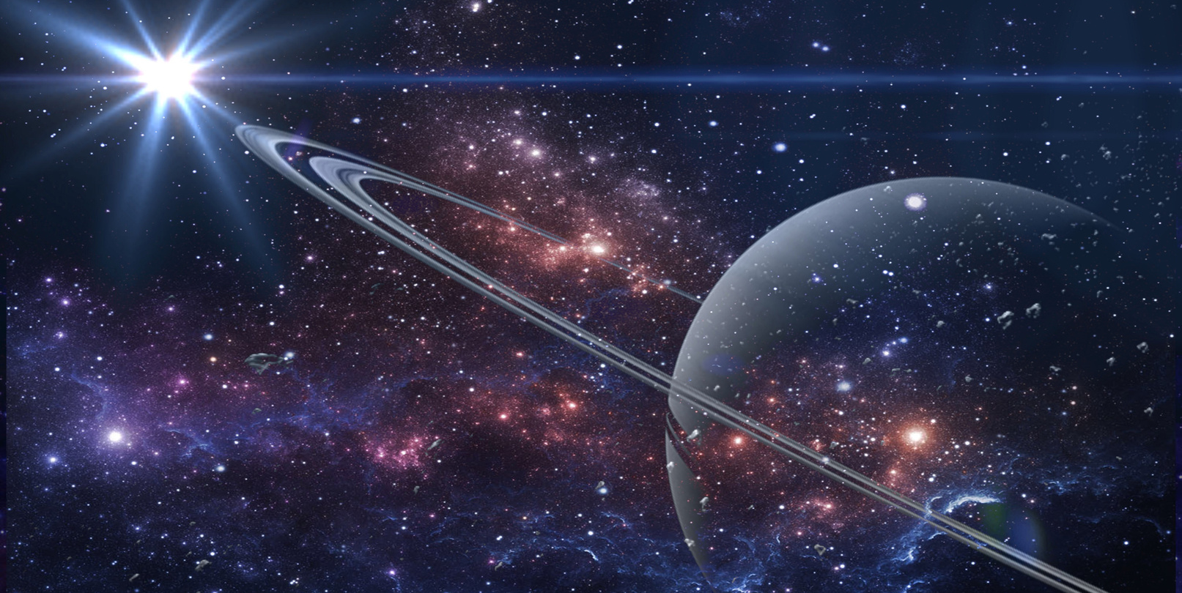
POSTULATES OF SPECIAL RELATIVITY
Principle of Relativity
  Uniform Motion
  Universality of Physical Laws
  Galilean Relativity Extension
  Non-Preference of Frames
CONSTANCY OF THE SPEED OF LIGHT
  Invariance
  Independent of Source
  Contradiction with Classical Physics
  Invariance

Slide 4

CONSEQUENCES OF SPECIAL RELATIVITY
LENGTH CONTRACTION
TIME DILATION
RELATIVITY OF SIMULTANEITY
  RELATIVE MOTION EFFECT
  DIRECTION OF MOTION
  FRAME-DEPENDENT SIMULTANEITY
  EXPERIMENTAL EVIDENCE
  EXPERIMENTAL EVIDENCE
  THOUGHT EXPERIMENTS
  FUNDAMENTAL CHANGE
  TWIN PARADOX
  OBSERVABLE ONLY AT HIGH SPEEDS
  IMPLICATIONS FOR SYNCHRONIZATION

Slide 5
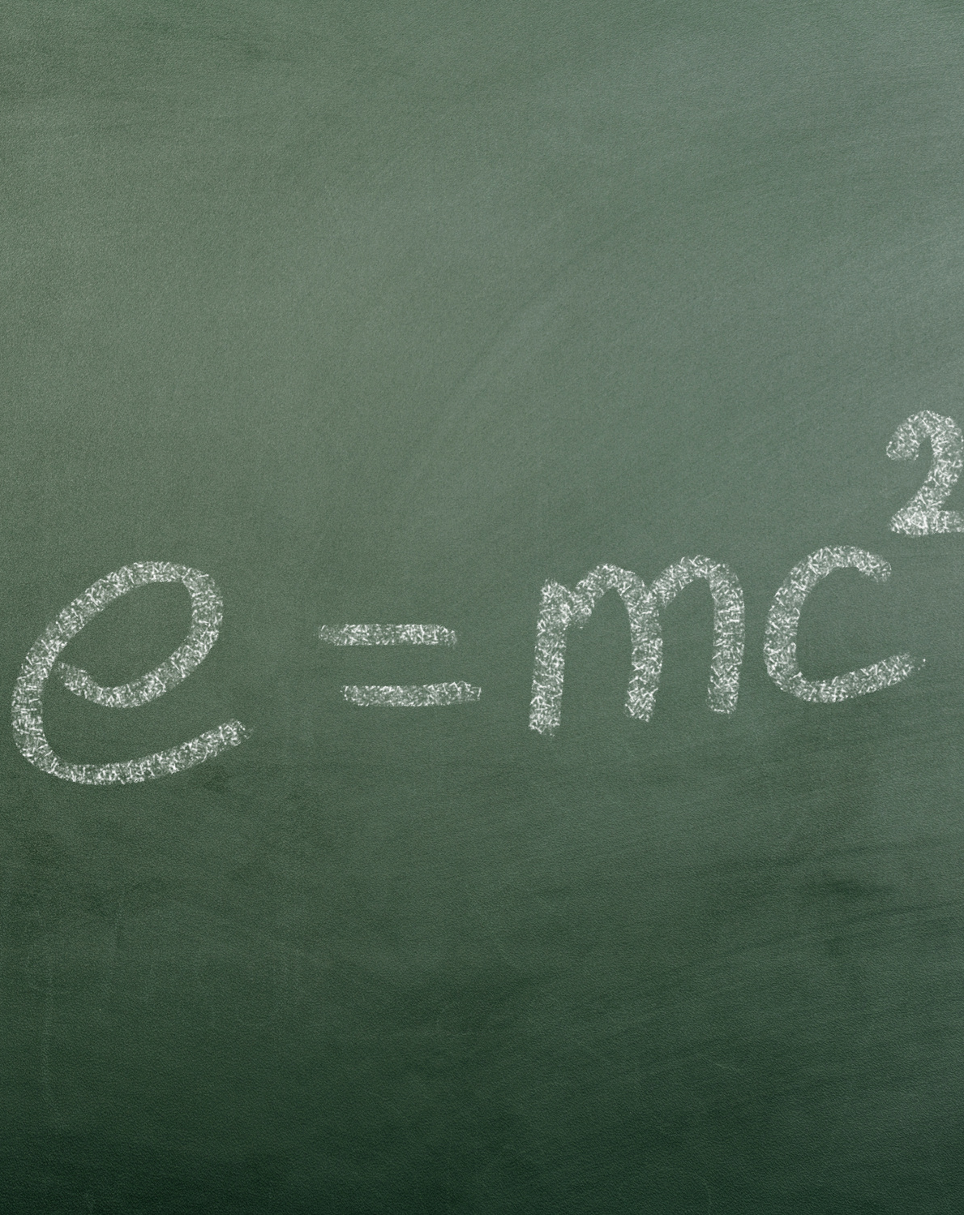
MASS-ENERGY EQUIVALENCE
  MASS-ENERGY EQUIVALENCE
  ENERGY FROM MASS
  MASS-ENERGY DUALITY
  BINDING ENERGY
  CONSERVATION OF ENERGY AND MASS
  MASS DEFECT

Slide 6

PRINCIPLE OF EQUIVALENCE
  PRINCIPLE OF EQUIVALENCE
  EXPERIMENTS AND OBSERVATIONS
  IMPLICATIONS FOR FREE-FALL
  LOCAL INERTIAL FRAMES
  CURVED SPACE-TIME
  GRAVITATIONAL TIME DILATION
  EINSTEIN'S FIELD EQUATIONS

Slide 7



GEOMETRY OF SPACE-TIME
  CURVATURE OF SPACE-TIME
  EINSTEIN'S FIELD EQUATIONS
  GEODESICS
  EXPERIMENTAL CONFIRMATIONS
  BLACK HOLES
  COSMOLOGY

Slide 8
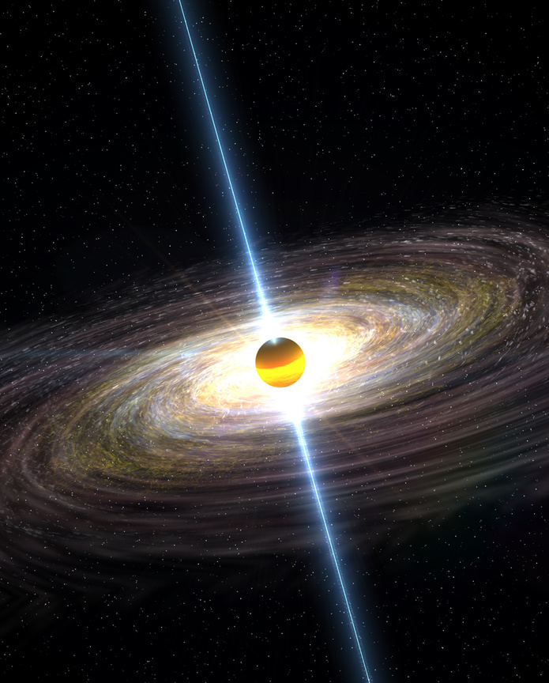
PREDICTIONS AND IMPLICATIONS OF GENERAL RELATIVITY
  PRECESSION OF MERCURY'S ORBIT
  BENDING OF LIGHT BY GRAVITY
Read More
  BLACK HOLES AND
  GRAVITATIONAL WAVES

Slide 9
ANY QUESTION?

Slide 10

THANK YOU
EVERYONE

